Slide 1
COMPETITION “OLYMPIC ENGLISH” 10th – 11th forms

Slide 2
“The most significant thing in the Olympic Games is not to win but to take part. Just as the most important thing in life is not the triumph but the struggle. The essential thing is not to have conquered but to have fought well”. Baron Pierre de Coubertin

Slide 3
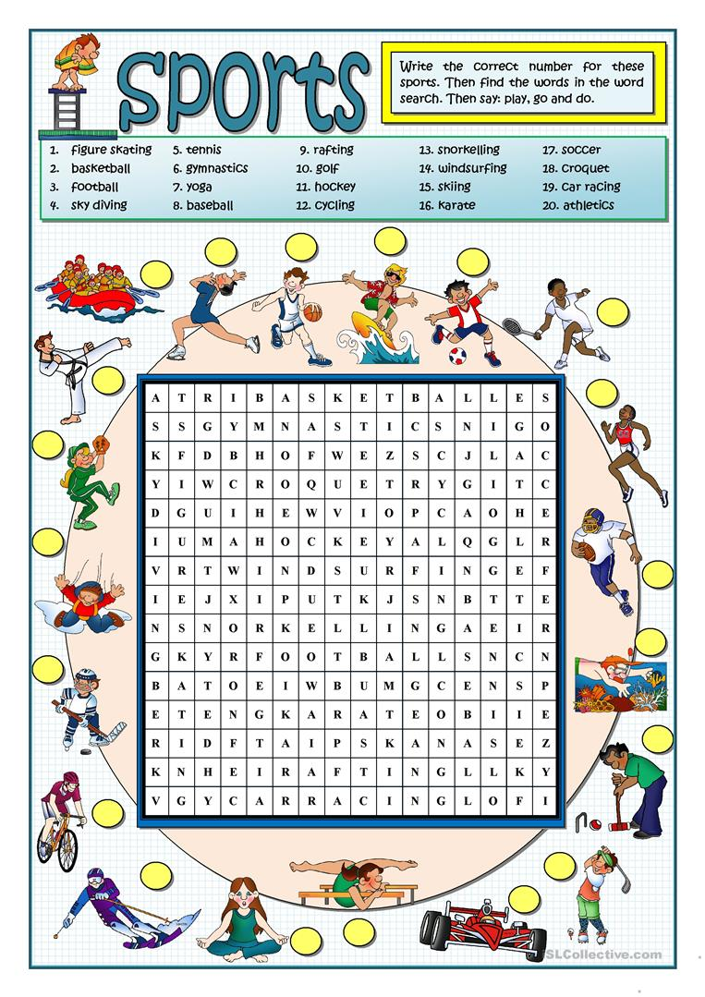

Slide 4
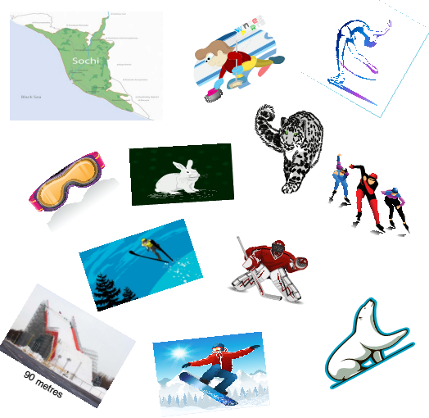

Slide 5
